Slide 1
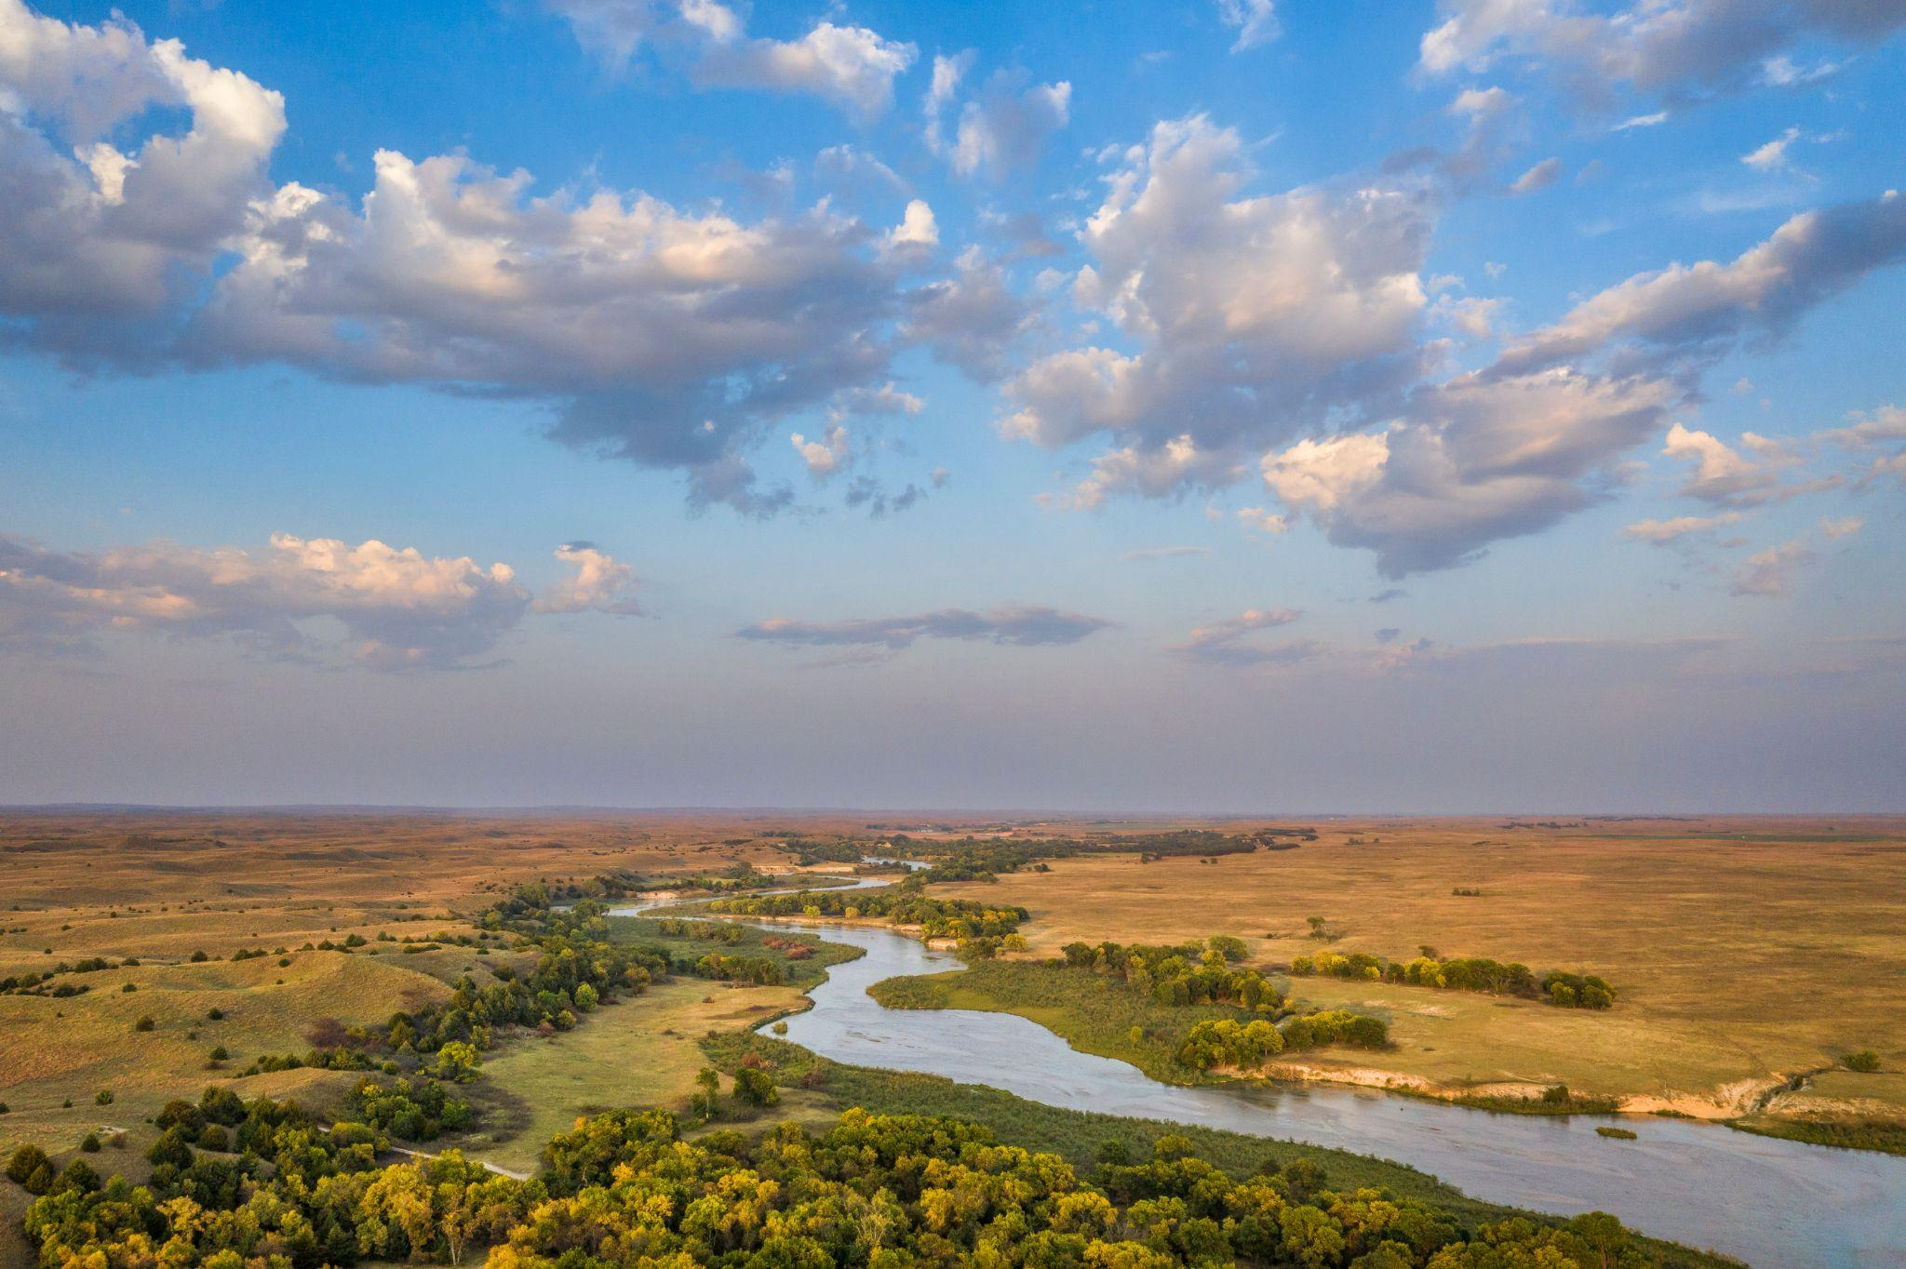
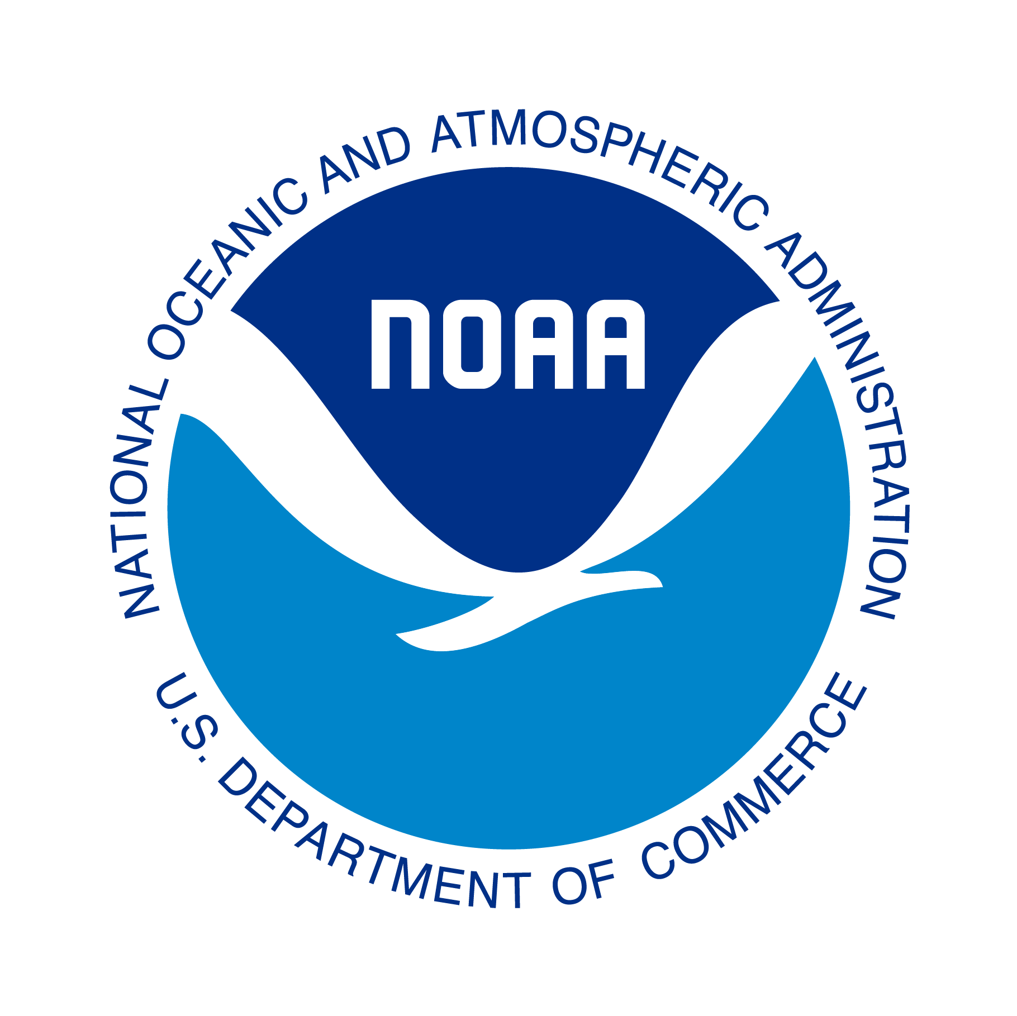
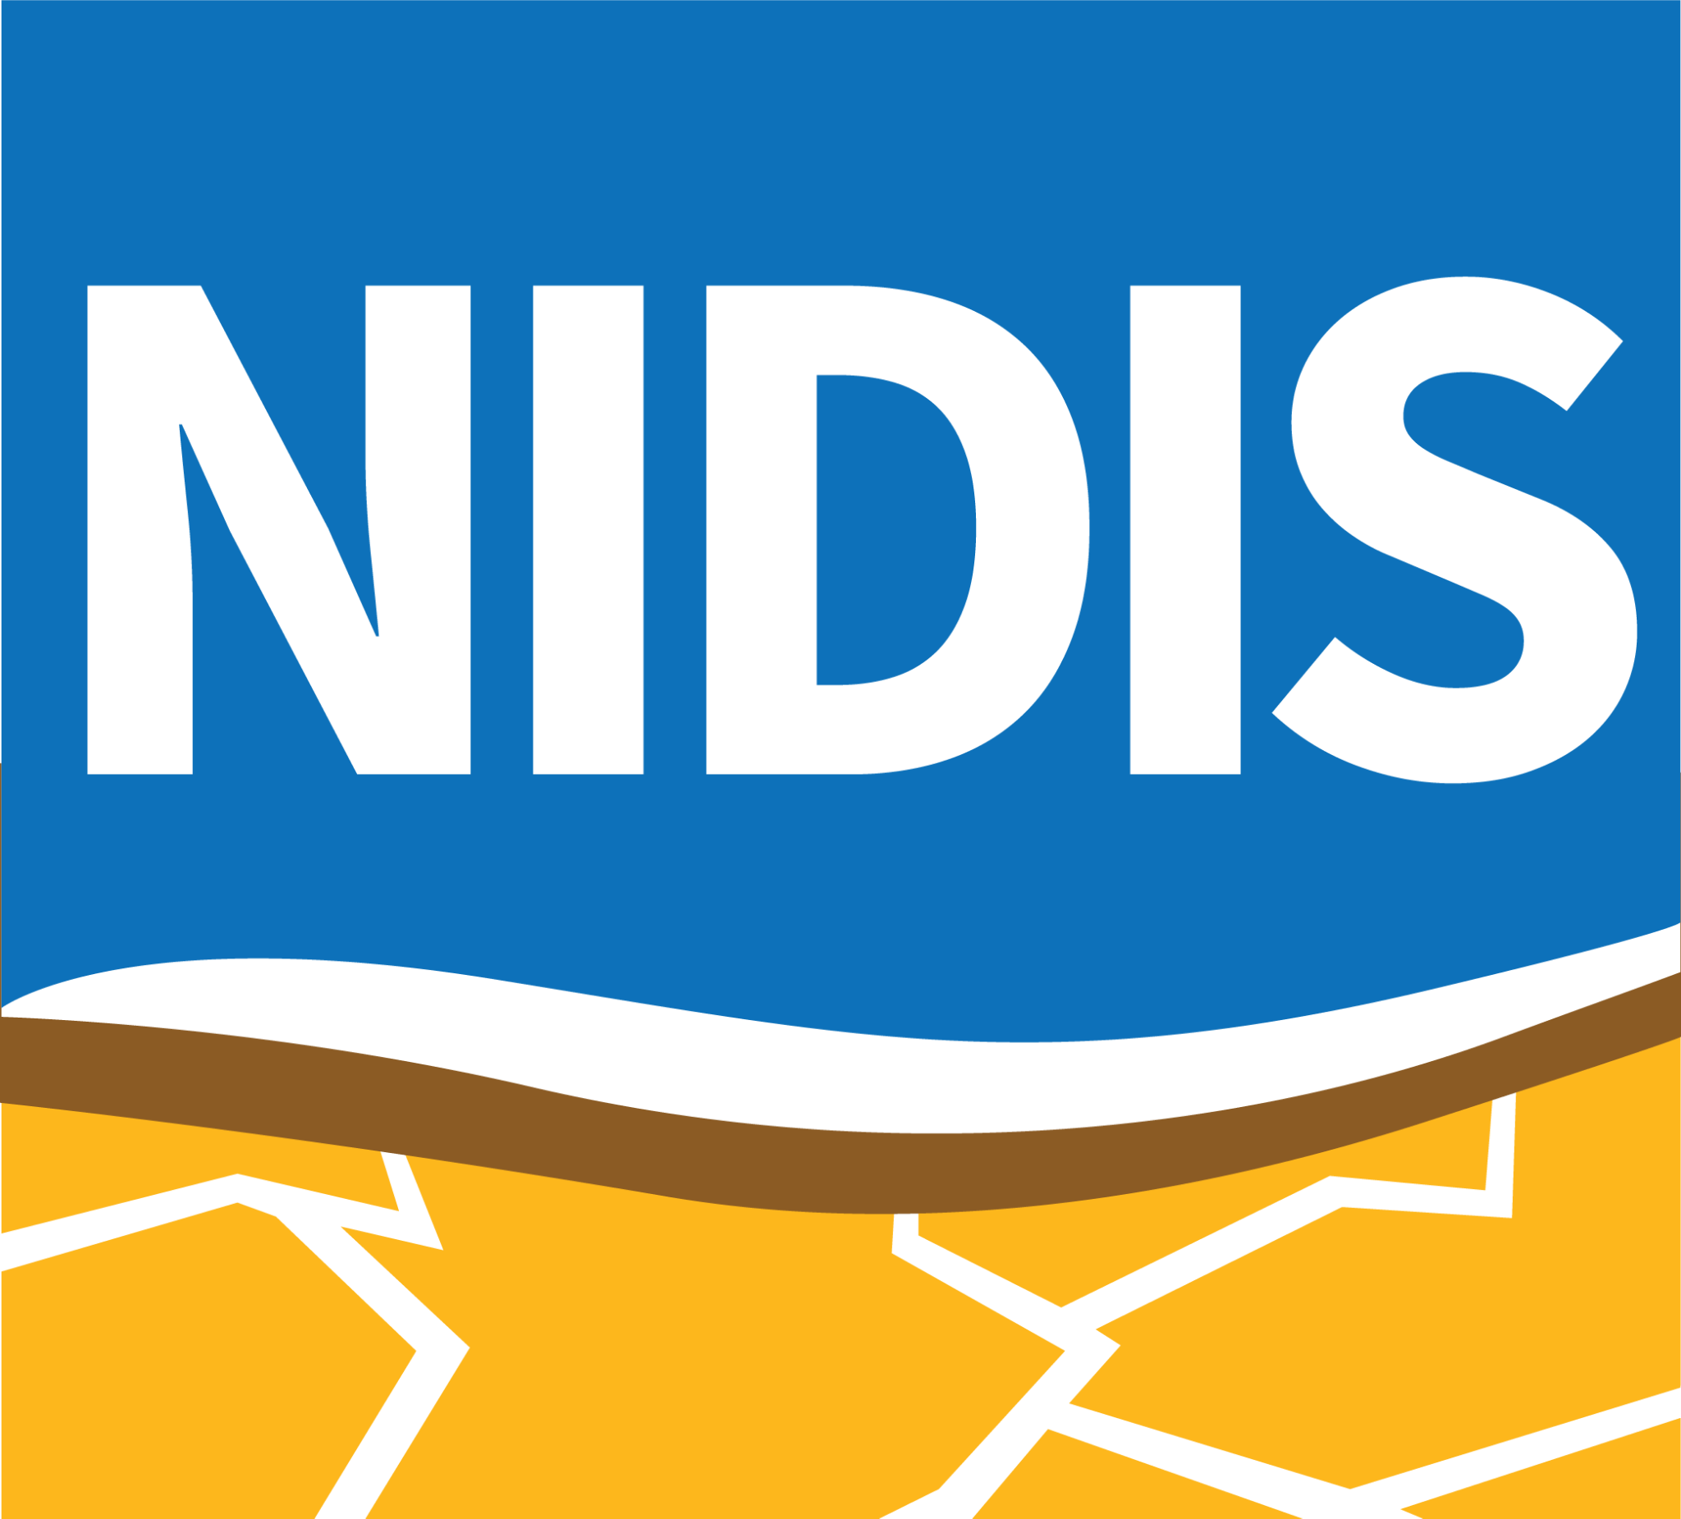
National Integrated Drought Information System (NIDIS)
Tribal Engagement Activities
Molly Woloszyn
GPTWA Meeting | Deadwood, SD
November 16-17, 2022

Slide 2
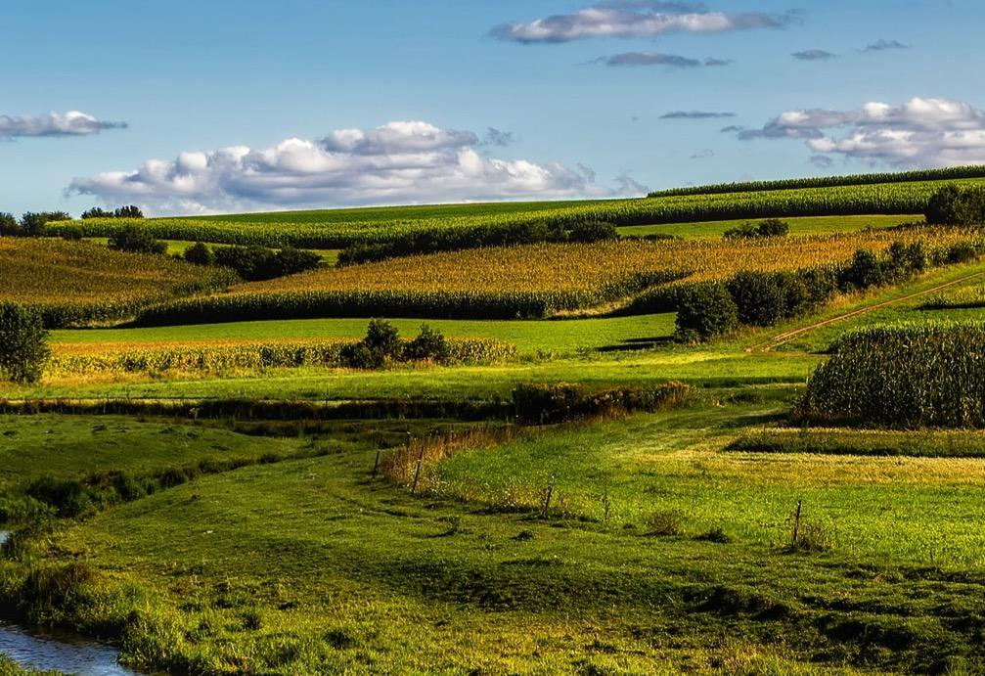
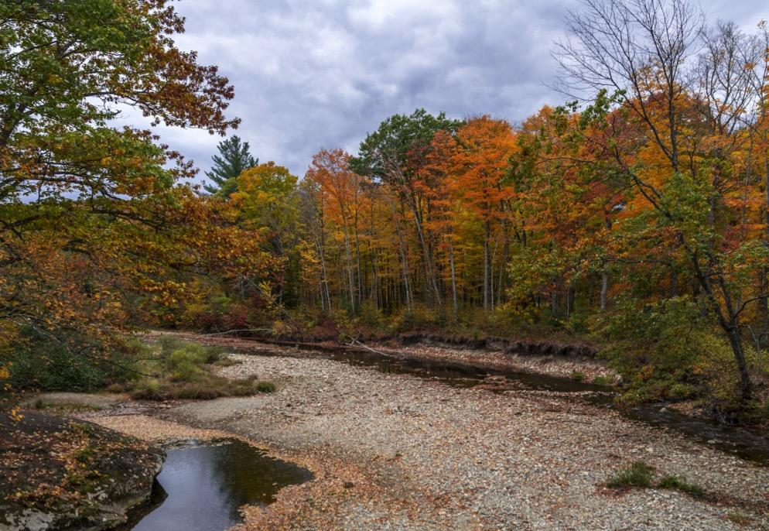
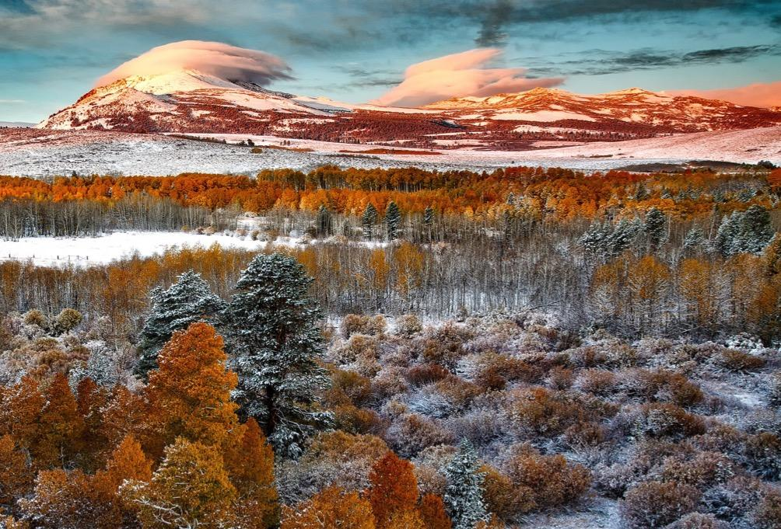
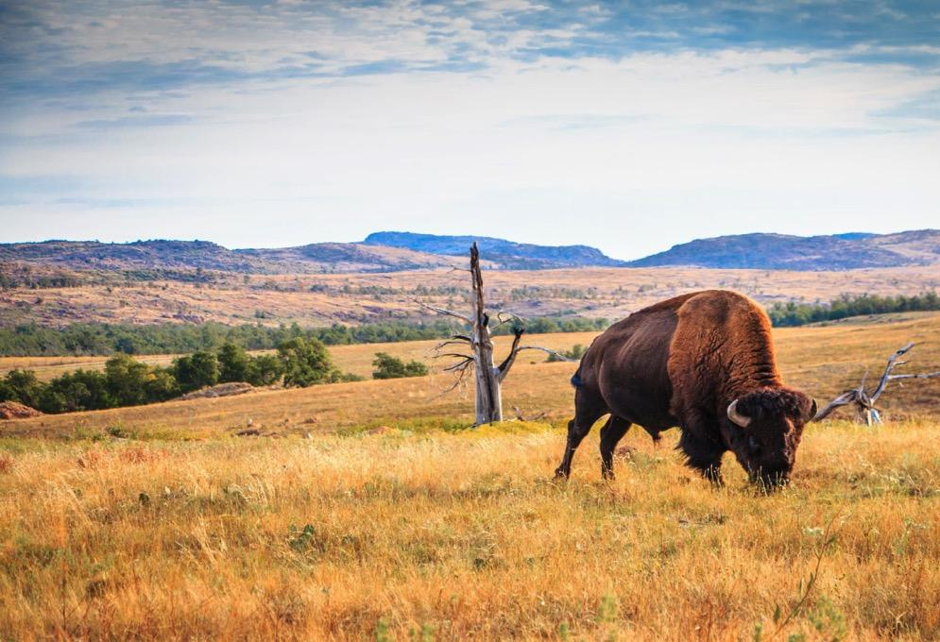
What is NIDIS?
First authorized by Congress in 2006; reauthorized in 2014 and 2018.
Interagency mandate to develop and provide a national drought early warning information system
Enable the Nation to move from a reactive to a more proactive approach to managing drought risks and impacts
Authorizes NIDIS to engage in partnerships with federal, state, tribal, and local partners, as well as the private sector, academic institutions, and citizen scientists
2018 Reauthorization: directs NOAA to develop a strategy for a national coordinated soil moisture monitoring network

Slide 3
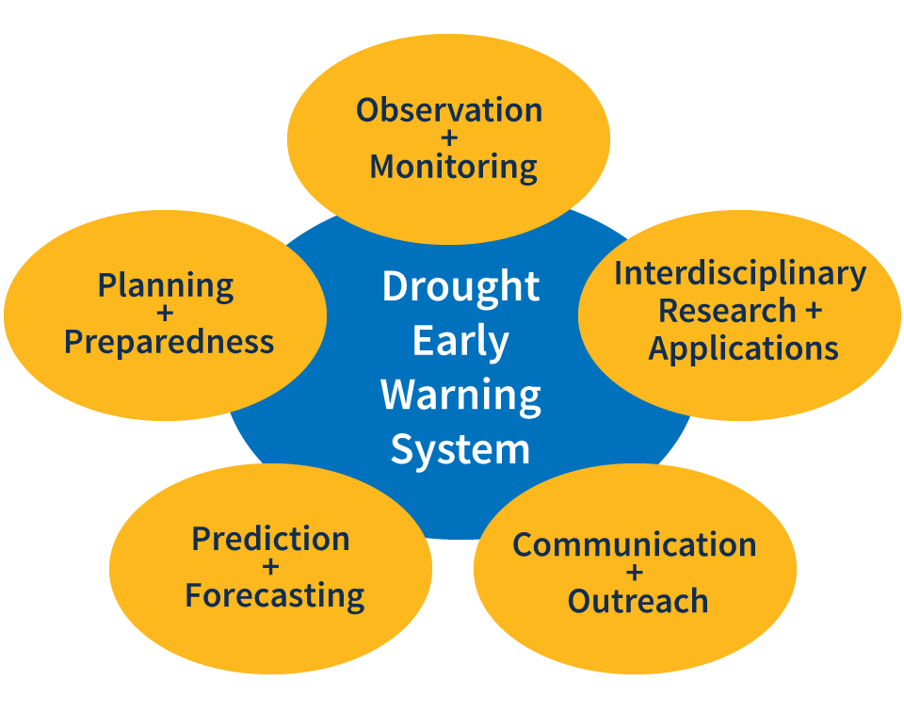
Drought Early Warning
APPROACH
“Provision of timely and effective information that allows individuals exposed to a hazard to take action to avoid or reduce their risk and prepare for an effective response.”

Slide 4
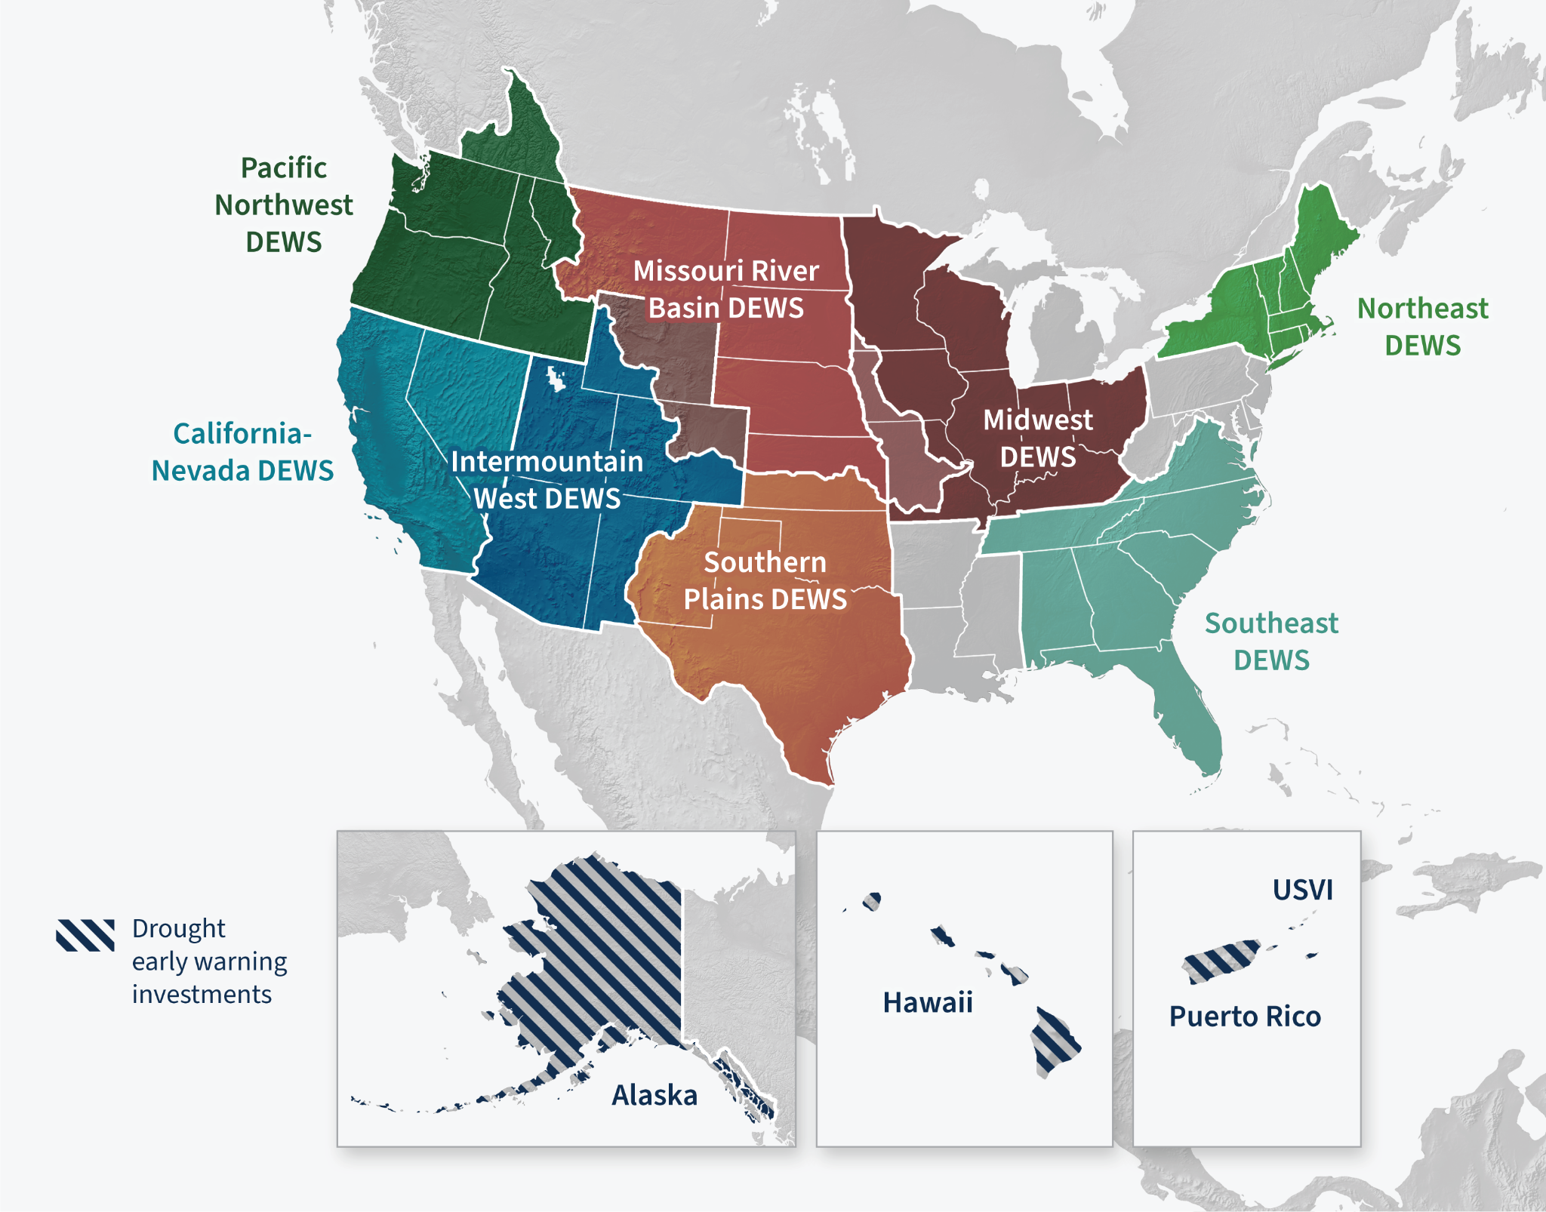
Drought Early Warning Systems
REGIONS
A Drought Early Warning System (DEWS) utilizes new and existing networks of federal, tribal, state, local and academic partners to make climate and drought science accessible and useful for decision makers.

Slide 5
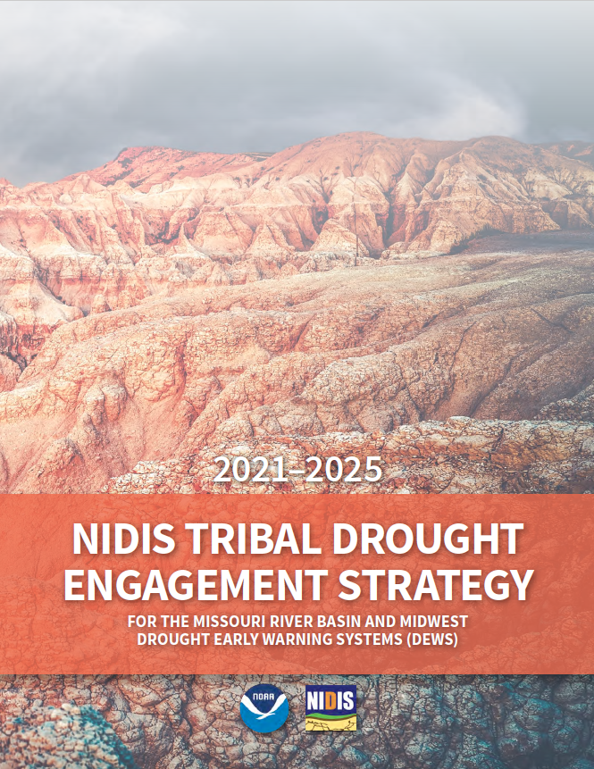
NIDIS Tribal Drought Engagement Strategy
NATIONAL INTEGRATED DROUGHT INFORMATION SYSTEM (NIDIS)
Key tribal engagement activities to implement in 2021 and beyond.
Integrating tribal perspectives into NIDIS’ work is important to ensure tribal nations are equal partners in responding to drought.
Presents Guiding Principles of Engagement:
Respecting tribal sovereignty
Ensuring trust and reciprocity
Ensuring DEWS are culturally appropriate and useful for tribal nations

Slide 6
Just Announced!
Four Tribal Drought Resilience Projects
Chími nukárihihi (Let’s Get Ready): Collaborative Climate Change and Drought Response Monitoring and Implementation (Karuk Tribe)
Native Drought Resilience: Confederated Salish & Kootenai Tribes (CSKT) Actions for Climate-Drought Adaptation
Developing a Drought Early Warning System and Indices for the Confederated Tribes of the Umatilla Indian Reservation
Strengthening Drought Preparedness on the Coeur d’Alene Reservation through Wetland Restoration and Monitoring
Notes:
Karuk Tribe: California
CSKT: Montana
Umatilla: Oregon
Coeur d’Alene: Idaho

Slide 7
NIDIS Tribal Strategy: Key Activities
Interdisciplinary Research and Applications Integrate the results of drought research into tribal decision-making and planning.
Prediction and Forecasting
Assist tribal partners in applying predictions and forecasts for drought.
Observations and Monitoring
Support the expansion of reservation-specific drought observation data.
Planning and Preparedness
Help with planning, but also help to advance action/implementation of actions.
Communications and Outreach
Ensure tribes are integral partners in the implementation of NIDIS.

Slide 8
Content for Tribal Partners
U.S. DROUGHT PORTAL
Drought.gov/tribal
Information available:
Drought monitoring on tribal lands
Drought impacts
Drought planning
Case studies/projects
Resources

Slide 9
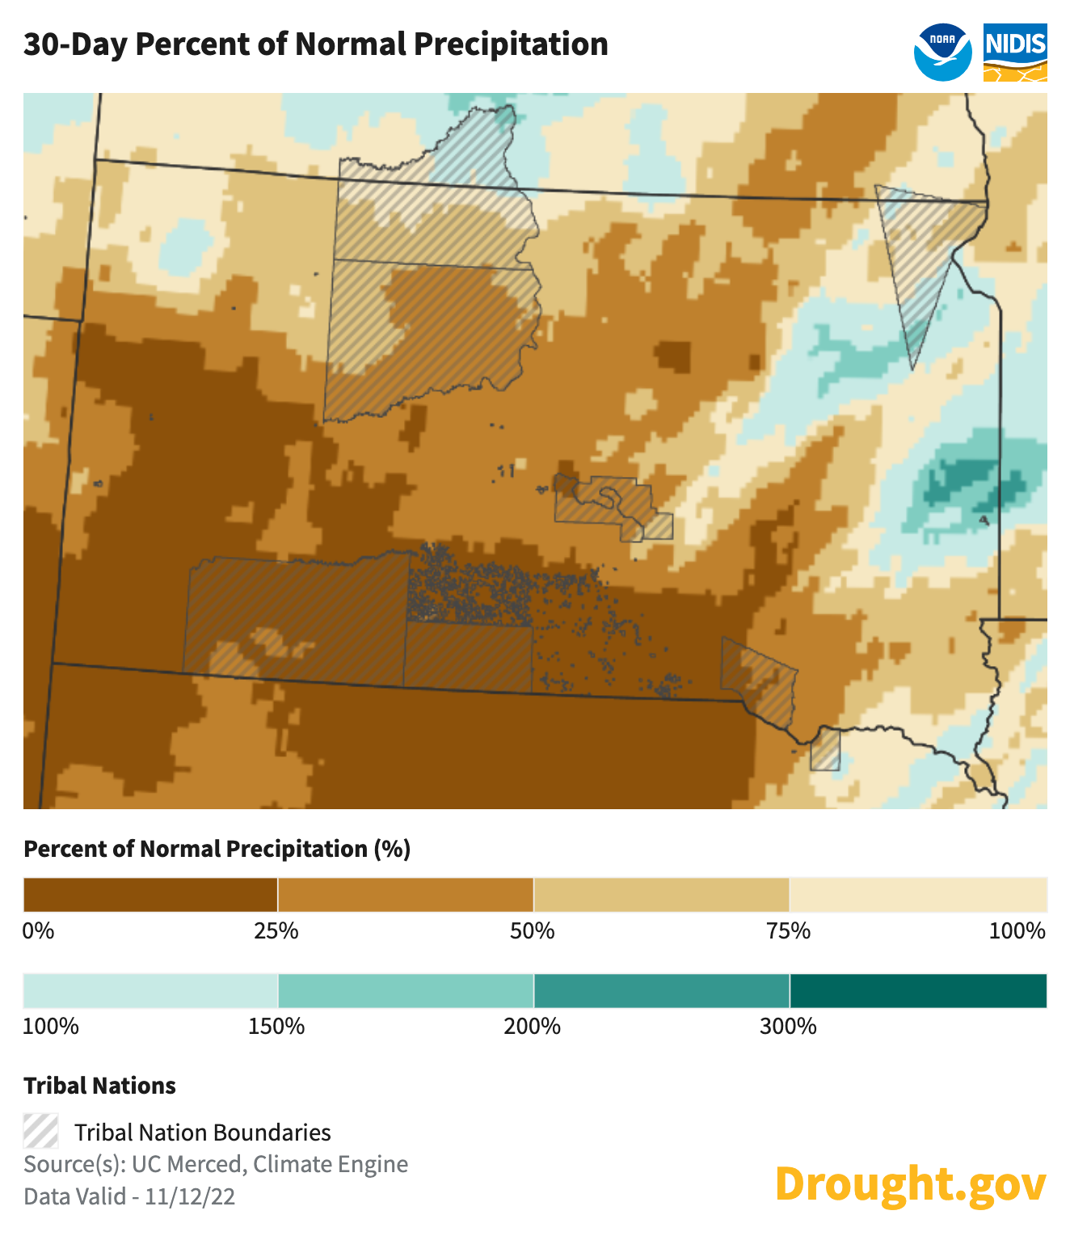
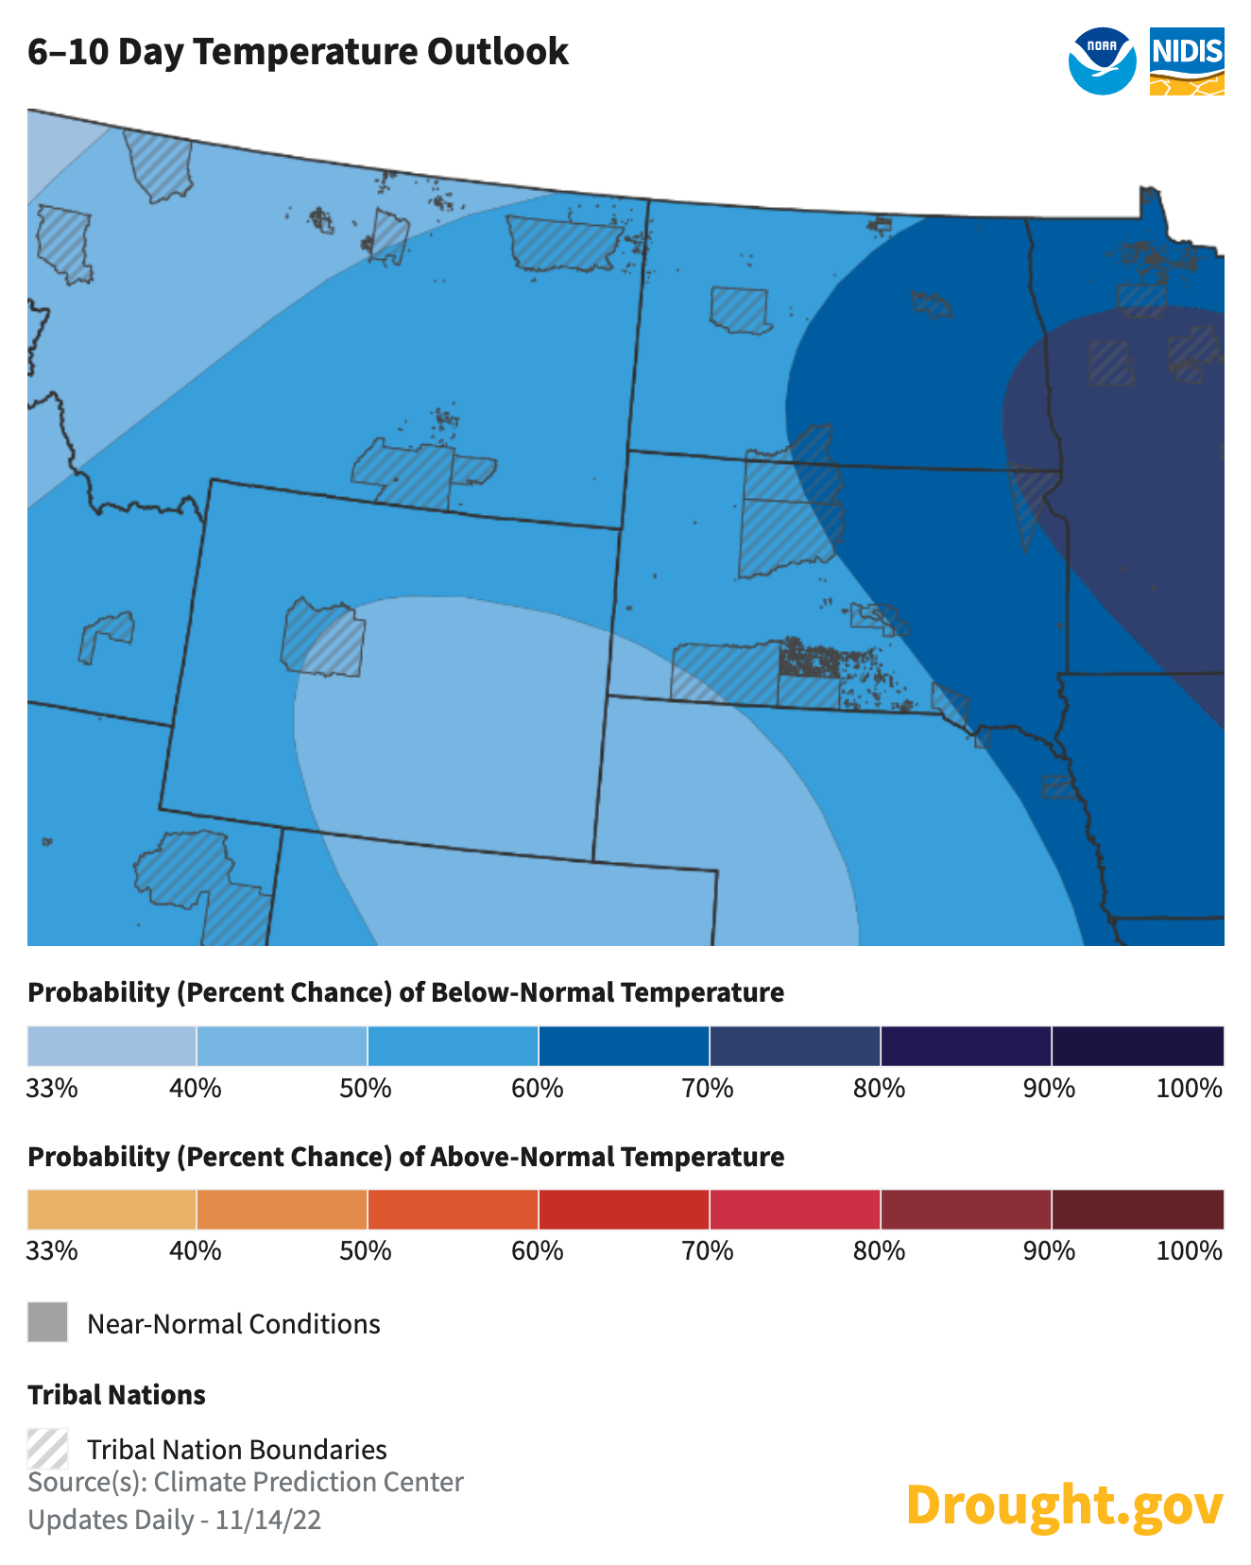
Content for Tribal Partners
U.S. DROUGHT PORTAL
*NEW*
All downloadable maps now have the option to add
Tribal Nation boundaries!!
Here’s a couple of examples:

Slide 10
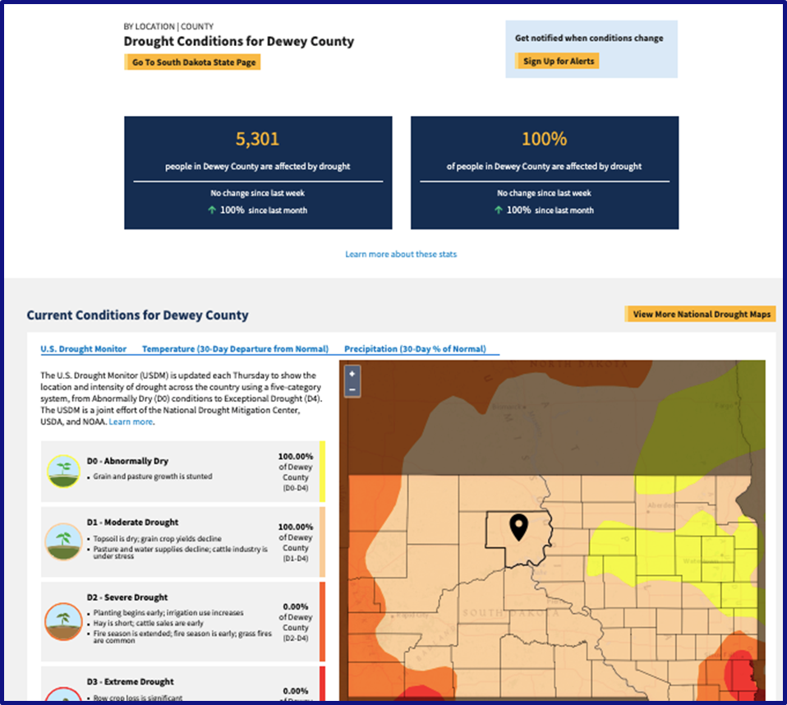
Future Plans
NIDIS TRIBAL ENGAGEMENT
Develop pages where you can drill down to tribal reservations for drought information.
Conduct regional listening sessions with tribal partners on future website development.
Hold drought action plan discussions with tribal partners.
Increased partnerships with TCUs

Slide 11
Missouri River Basin DEWS
Strategic Action Plan
Key Priorities
Drought indicators & impacts to inform planning
Proactive drought management actions
Integrated/applied research
Collaboration and network building

Slide 12
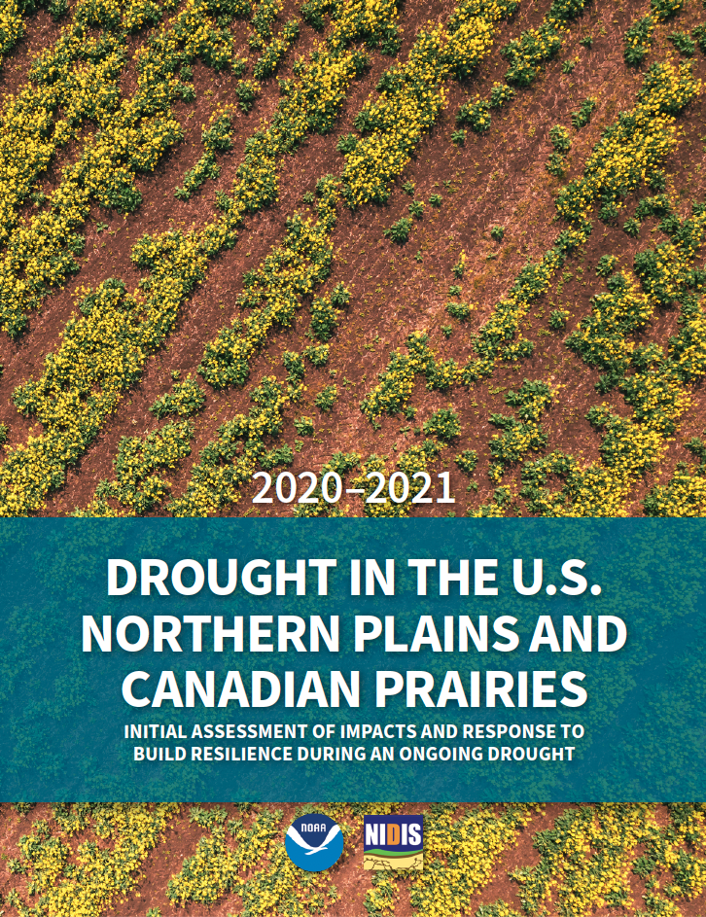
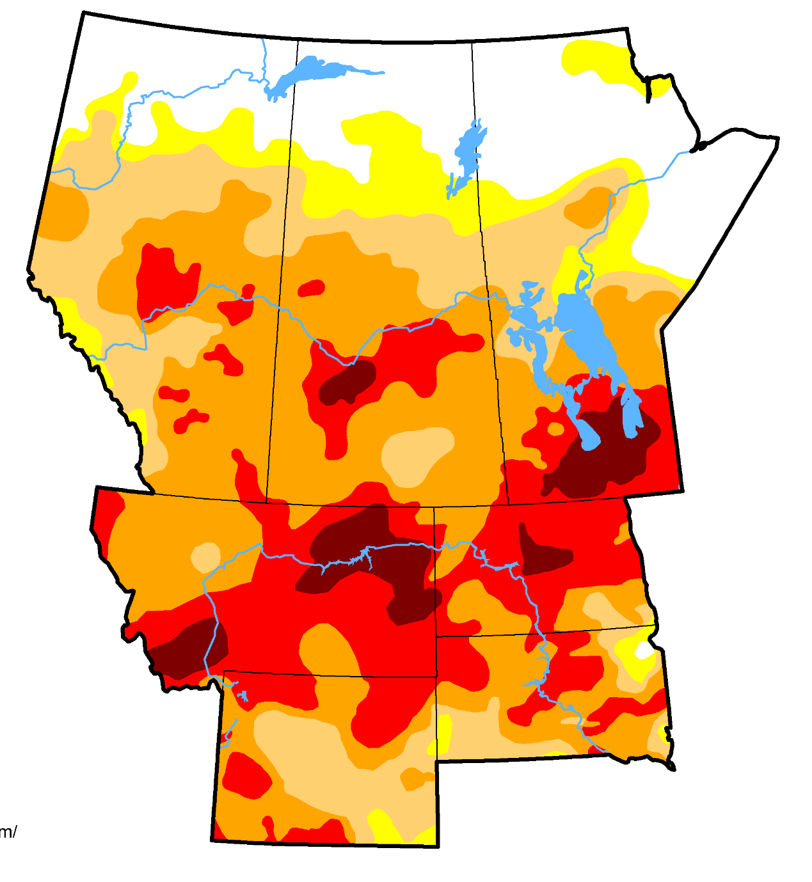
2020-2021
MRB Drought Assessment
COMING SOON!
Overview of…
Evolution
Impacts
Response
New/ongoing needs and gaps
August 31, 2021

Slide 13
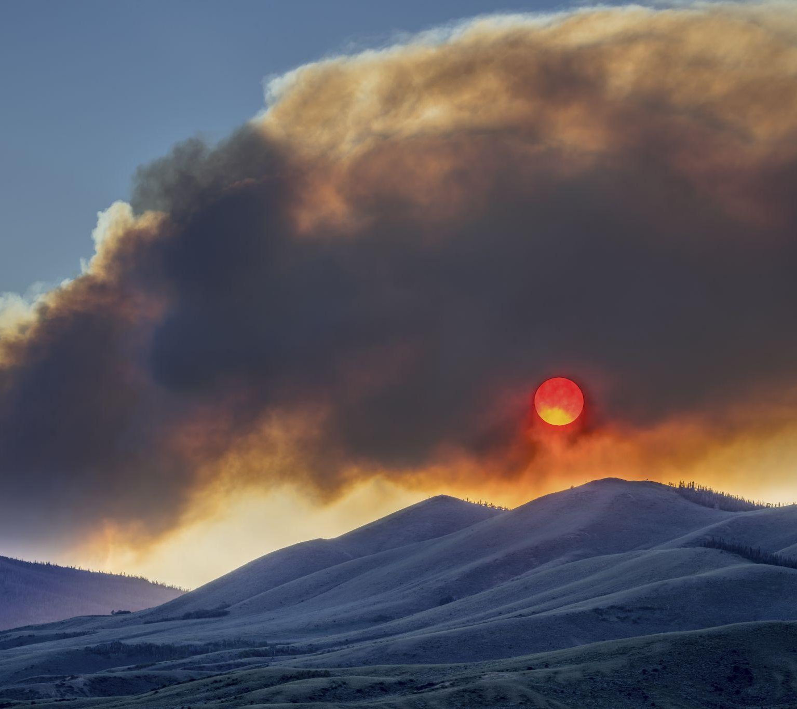
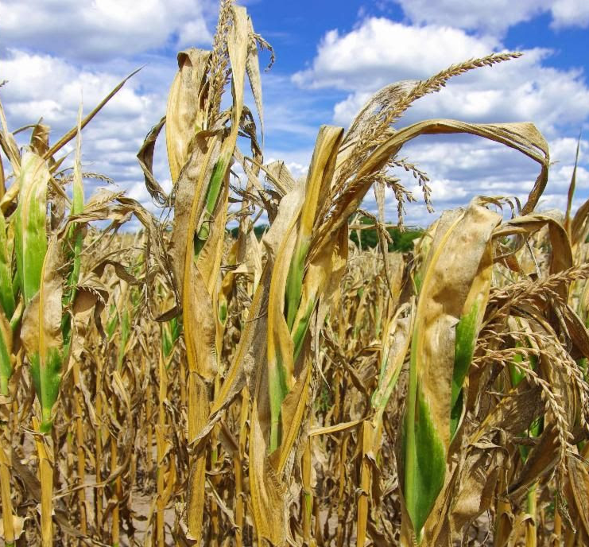
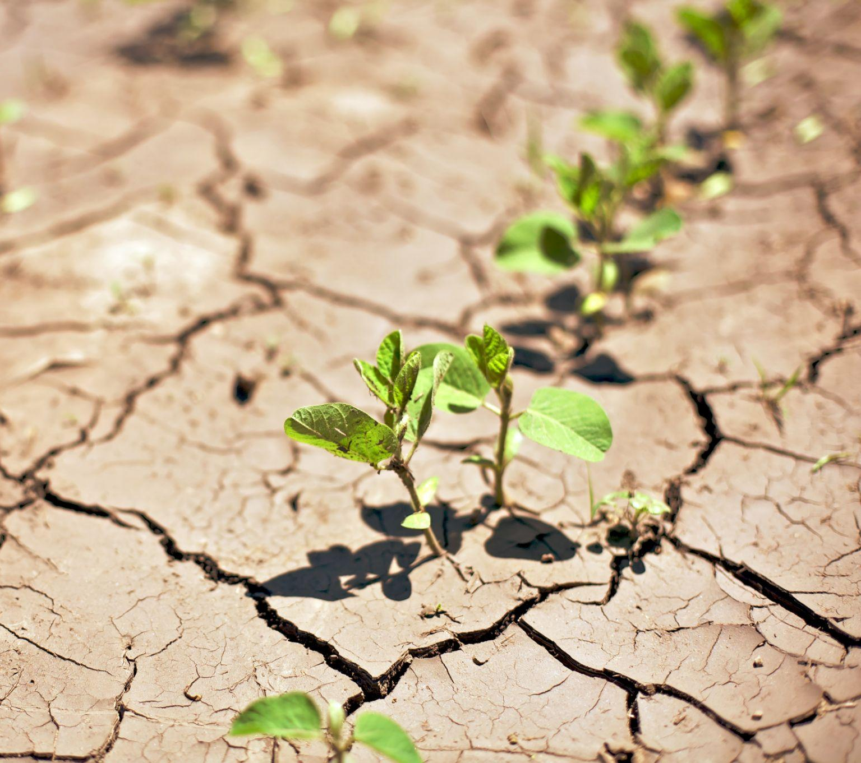
NIDIS in Action Across the U.S.
NATIONAL INTEGRATED DROUGHT INFORMATION SYSTEM (NIDIS)
Drought & Human Health
Drought in a Changing Climate
Drought Indicators and Triggers
Drought &
Wildfire
Flash Drought
Soil Moisture
Notes:
Remote sensing data can and does really come in with ALL of these topics that we work in - remote sensing is very important in the drought space. Particularly when we’re looking at areas where observational data might not be as plentiful - either here in the US or especially globally.

Slide 14
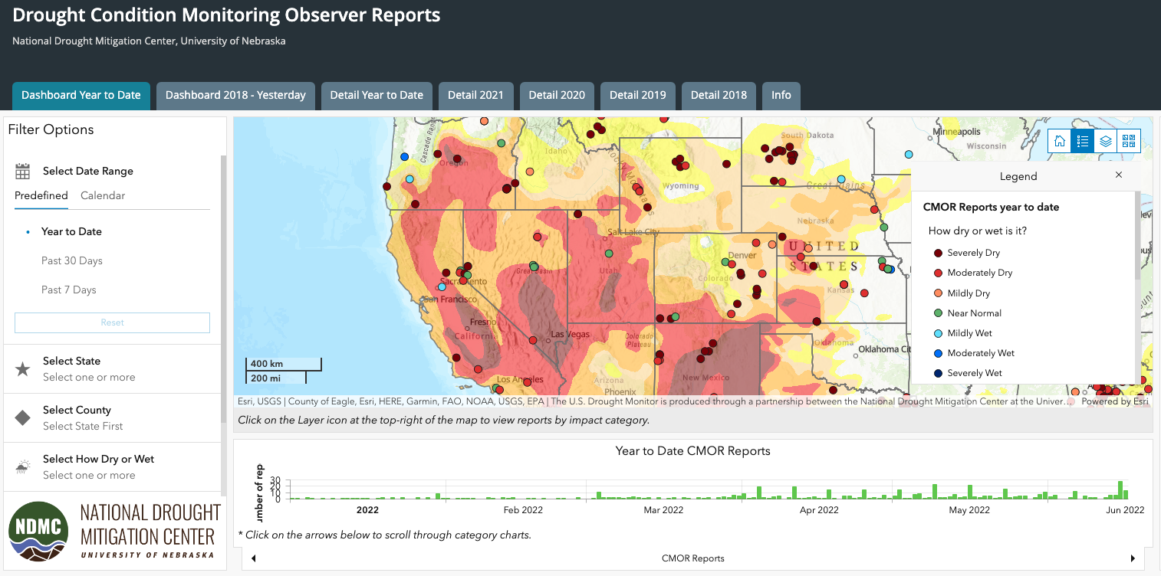
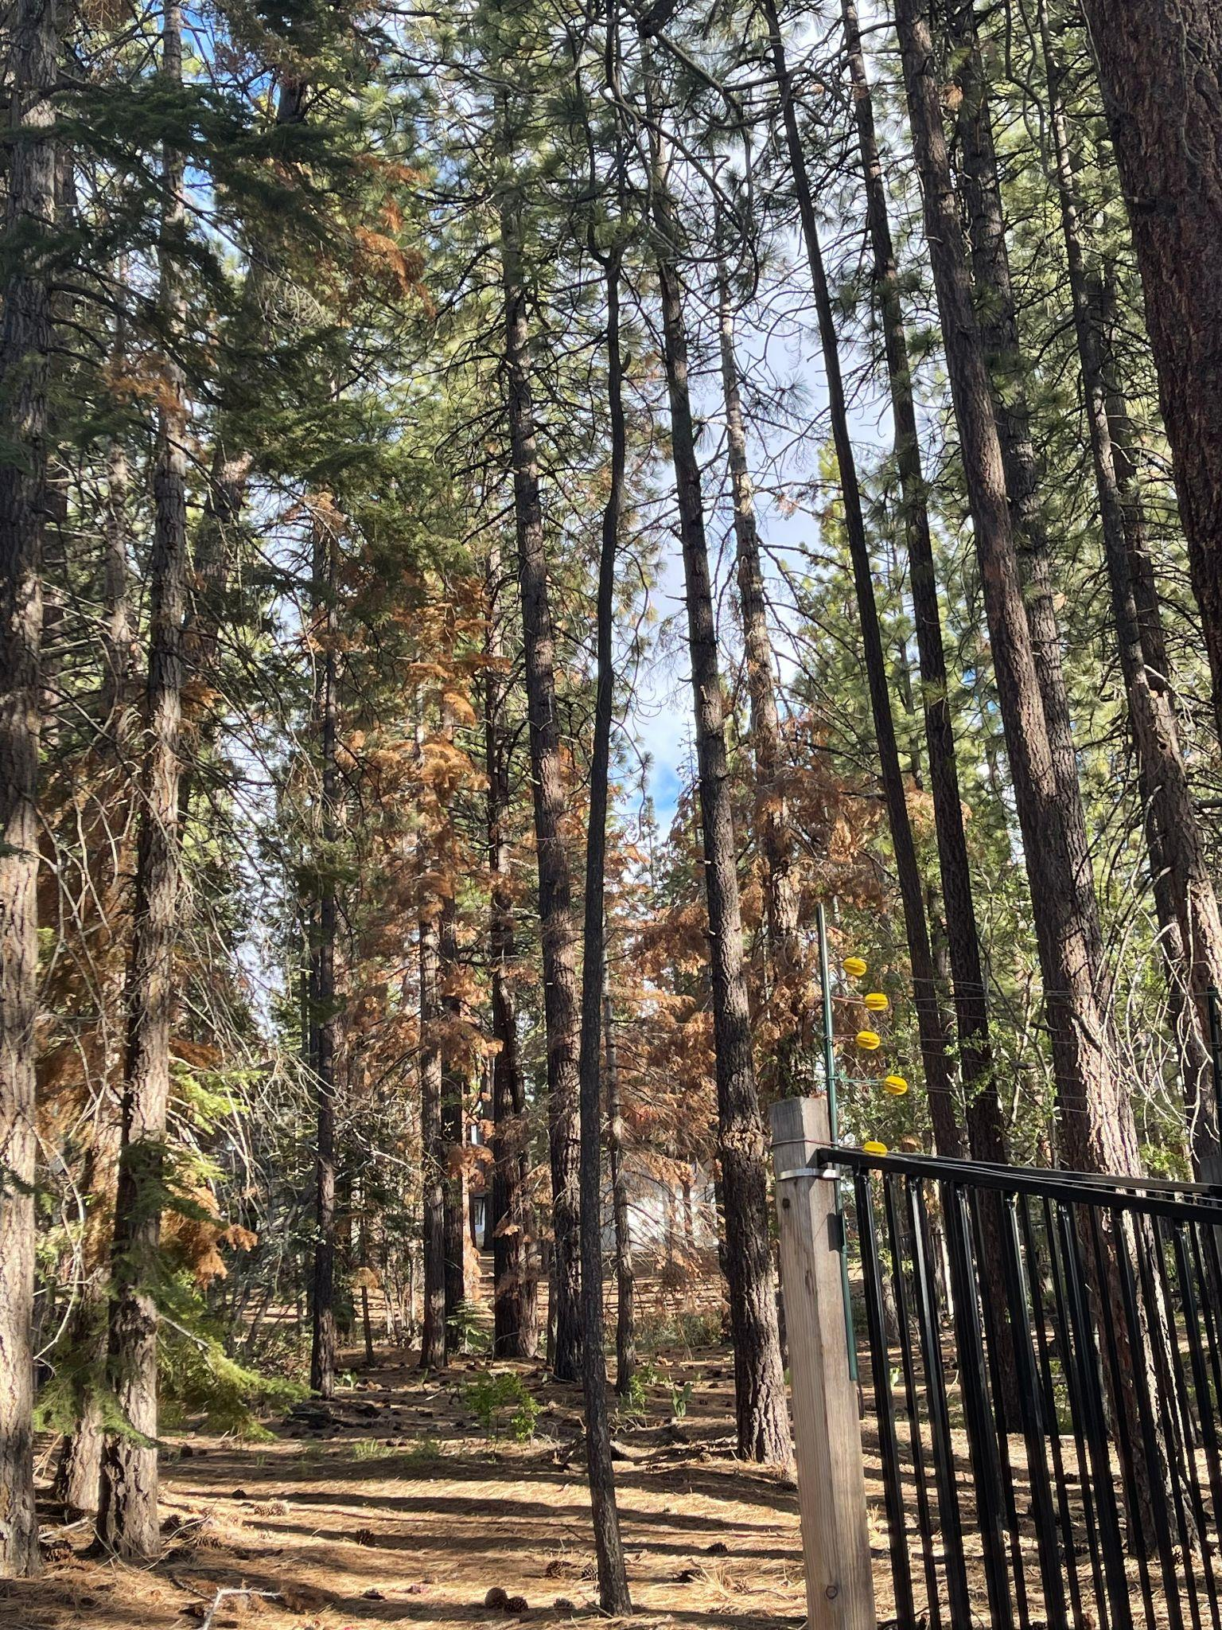
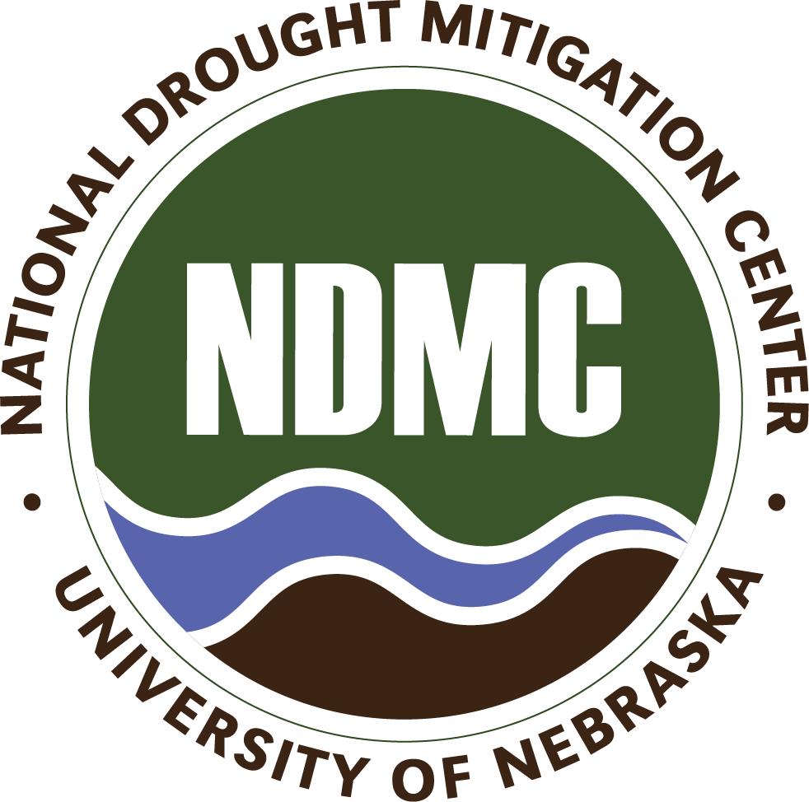
Drought Impact Reporting Resources
It is really important to know what is happening on-the-ground for drought monitoring, response, and planning.
There is a system for anyone to report their conditions on the ground (text/photos).
Condition Monitoring Observer Reports (CMOR): https://droughtimpacts.unl.edu
“Widespread rapid tree death is occurring particularly with for trees in this area. Wildlife has been forced to migrate into new areas as a result of the lack of surface water that is typically available at this time.”

Slide 15
Thank You
Please reach out! molly.woloszyn@noaa.gov
www.drought.gov
@DroughtGov
@DroughtGov
National Integrated Drought Information System

